Slide 1
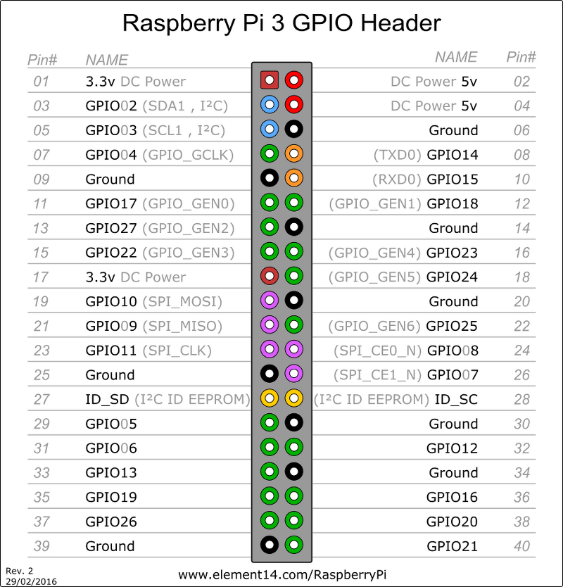
B
G
R
-
SCL
SDA
VCC
VCC
SDA
SCL
R
G
GND
B

